Slide 1
Tilemaps using Tiled and Phaser

Slide 2
Tilemaps
Tilemaps are layered maps created for games using images split up into tiles, generally 16 x 16 pixels or 32 x 32 pixels in size. These images are known as Tilesets. These are special types of images that are built to be split up into these tiled segments.

Slide 3
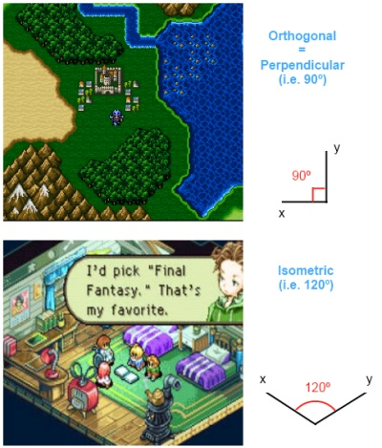
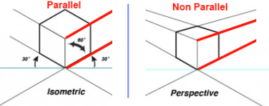
Orthogonal vs Isometric game
Source: http://gamedev.stackexchange.com/questions/22277/difference-between-orthogonal-map-and-isometric-map

Slide 4
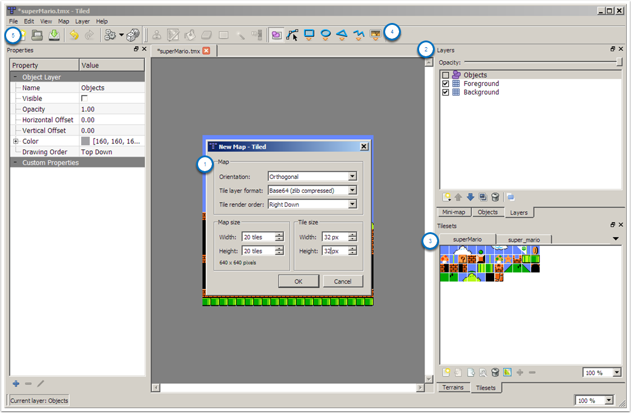
Tiled editor
a visual editor to create Tilemaps and to export datafiles.
create a new tilemap
Layer Palette
Tilesets Panel
Drawing/Editing Tools
File > Export option to create JSON files
Download at: http://www.mapeditor.org/

Slide 5
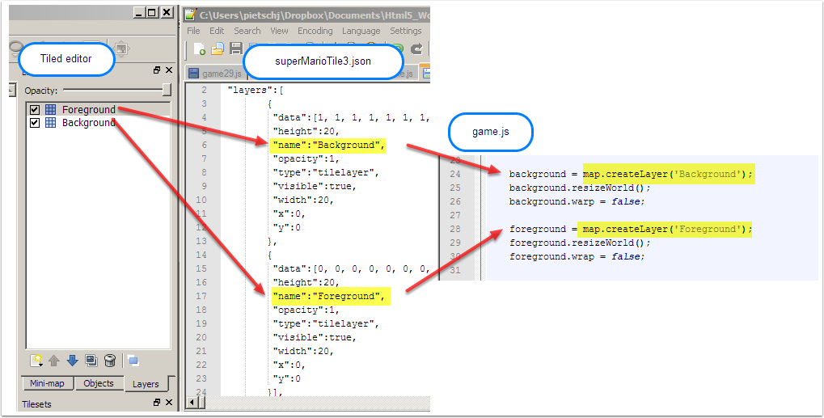
relationship of Tiled editor, json and game.js

Slide 6
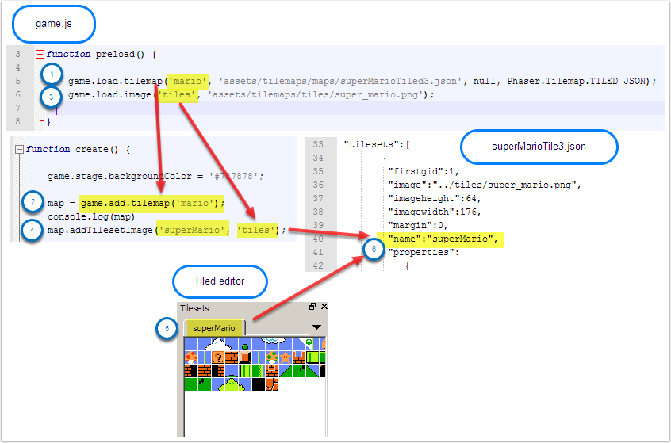
How to load Tilemaps in Phaser.
a Tilemap Json file is loaded and given a key (in this example mario.
In the create method, the tilemap is added to the game by using its key ('mario');
an accomanying tileset image is loaded and assigned the key ('tiles')
In the create method, the tileset asset is loaded and assigned the key ('superMario')
This key has to match the Tileset name inside the Tiled editor
This key has to match the "name" property in the tilesets array of the JSON file

Slide 7
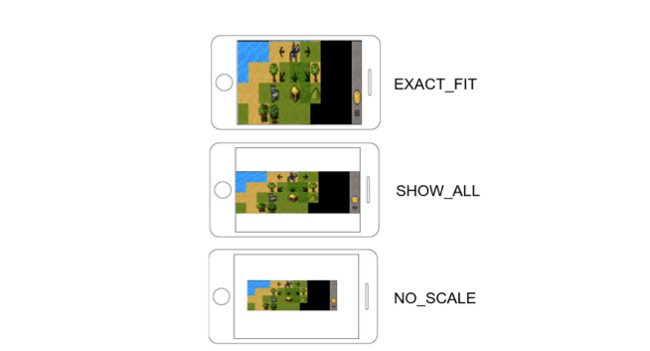
Phaser Scale Manager
http://phaser.io/docs/2.6.2/Phaser.ScaleManager.html

